Slide 1

RATING PREDICTION
Presented by:
JAYASURYA E

Slide 2
Problem Statement
We have a client who has a website where people write different reviews for technical products. Now they are adding a new feature to their website i.e. The reviewer will have to add stars(rating) as well with the review. The rating is out 5 stars and it only has 5 options available 1 star, 2 stars, 3 stars, 4 stars, 5 stars. Now they want to predict ratings for the reviews which were written in the past and they don’t have a rating. So, we have to build an application which can predict the rating by seeing the review

Slide 3
EDA(Exploratory Data Analysis)

Slide 4
Data Description
The dataset contains 20050 records (rows) and 3 features
(columns).Here, we will provide a brief description of dataset
features. Since the number of features is 3, we will attach
the original data description file to this study for more
information about the dataset. Now, we will mention the feature
name of product, rating and review.

Slide 5
Target Variable
Review based rating prediction: It’s multi-class classification type of data, so the model approach is carried out for Classification analysis.
Classification:
It is a process of categorizing a given set of data into classes, It can be performed on both structured or unstructured data. The process starts with predicting the class of given data points. The classes are often referred to as target, label or categories.

Slide 6
Data Pre-processing
Rating
Counts
5
4
1
3
2
11671
4095
2202
1439
643

Slide 7
Data Cleaning

Slide 8
Encoding of Data Frame:
Since the dataset has a lot string values. We will use the NLP techniques.
Column Data types
Product object
Rating object
Review object

Slide 9
Now, we proceed with NLP Technique
To Convert all message to lower case:
To Remove Punctuation
To Replace whitespace between terms with a single space.
To Remove leading and trailing white space
To Replace numbers with 'numbr'
To Replace Urls with 'webaddress'
To Remove Stopwords.

Slide 10
Total length removal of review feature:
Original Length: 1445748
Cleaned Length: 999563

Slide 11
Visualization

Slide 12
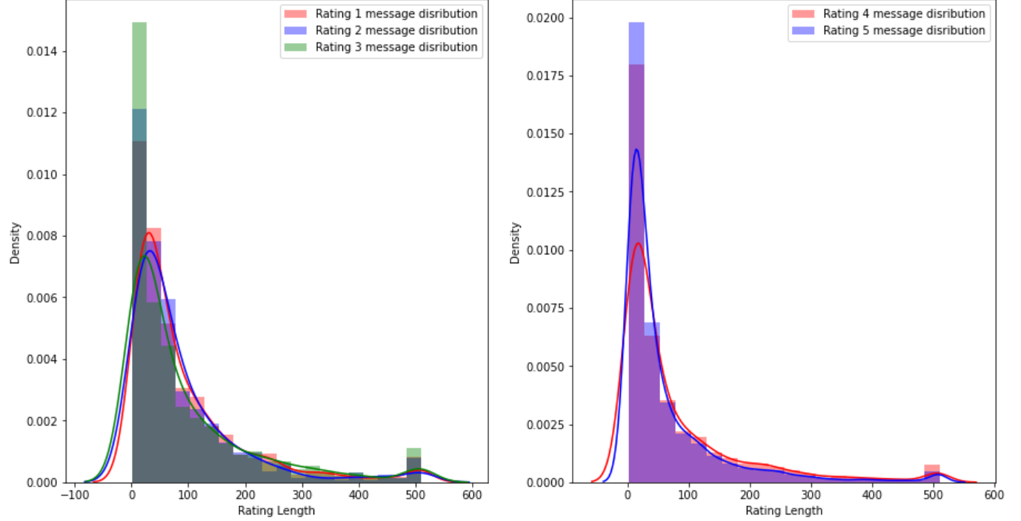
Message distribution before data cleaning:

Slide 13
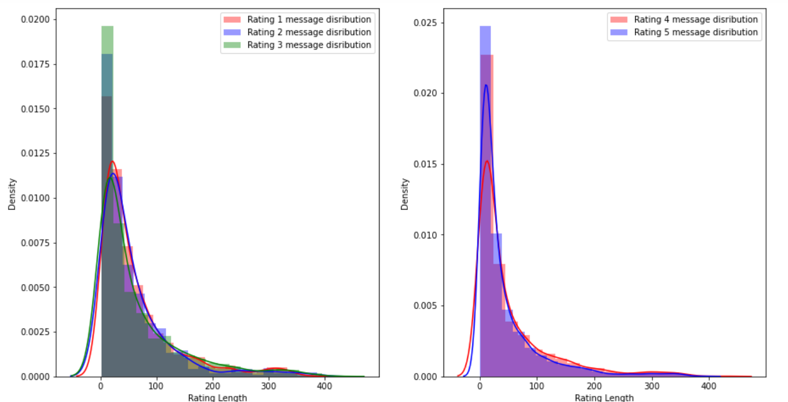
Message distribution after data cleaning:

Slide 14
Model Building and Evaluation
These are modelling approach made to build an model :
MultinominalNB
SGD
Kneighbors
LinearSVC

Slide 15
Performance Metric
Model Building | Accuracy Score | Macro average | Weighted average
MultinominalNB | 0.64 | 0.27 | 0.53
SGD | 0.68 | 0.36 | 0.59
KNeighbors | 0.60 | 0.33 | 0.56
LinearSVC | 0.66 | 0.41 | 0.61
According to performance metric, the SGD has higher Accuracy score, So this is our best model.

Slide 16
Comparison:
Performance Metric | Cross -Validation Score
0.64 | 0.63
0.68 | 0.65
0.60 | 0.57
0.66 | 0.62
Comparing the performance model and cross-validation score which has minimum difference is Multinominal NB. so finally, this is our best model.

Slide 17
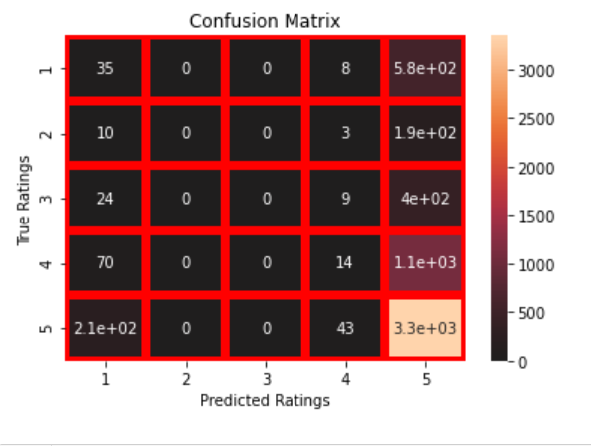
Confusion Matrix

Slide 18
Hyper Parameter Tuning
The Hyper parameter tuning is carried out for Multinominal NB Classifier model.
Because performance metric score is 0.64.

Slide 19
Hyper Parameter Tuning Performance
: Multinominal NB Classifier :
Accuracy Score : 66.46
Cross validation Score : 62.71

Slide 20
Best Model
Hyper parameter Tuning performance is carried out for Multinominal NB Classifier :
Hyper parameter Tuning i.e., Accuracy score = 66.46 and 62.71 respectively. Finally, Multinominal NB best model for these dataset.

Slide 21
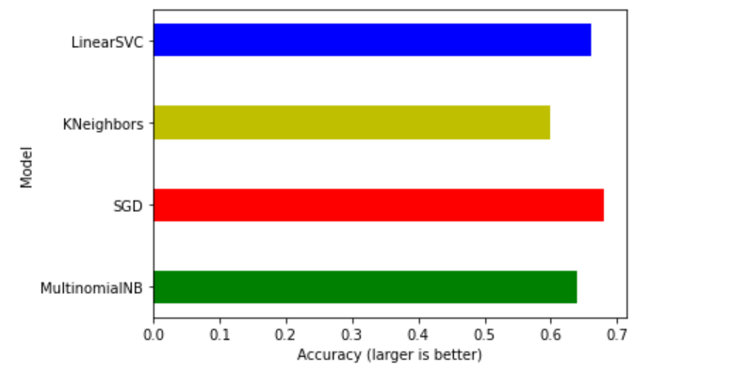
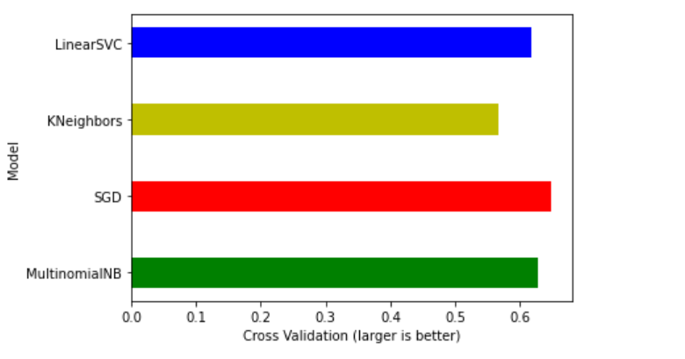
Performance Interpretation:
Accuracy Score
Cross Validation Score

Slide 22
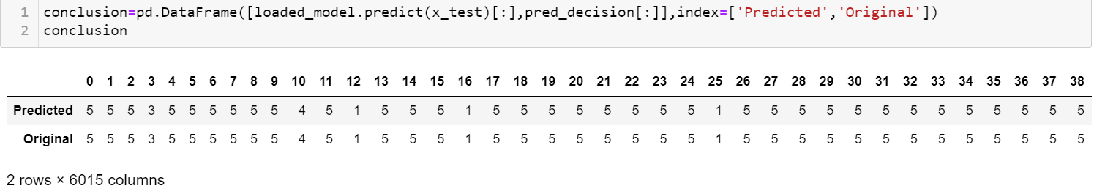
Conclusion:
In this paper, we built several classification models to predict the review-based ratings of some product features. We evaluated and compared each model to determine the one with highest performance. We also looked at how some models rank the features according to their importance. In this paper, we followed the NLP technique and Machine learning algorithm process starting with getting the data, then cleaning and pre-processing the data, followed by exploring the data and building models, then evaluating the results.
As a recommendation, we advise to use this model (or a version of it trained with more recent data) by e-commerce sector who want to get an idea about product. The model can be used also with datasets that covered areas provided that they contain the same features. We also suggest that people take into consideration the features that were deemed as most important as seen in the previous section; this might help them estimate the review-based rating prediction is better.

Slide 23
Thank you

